Slide 1

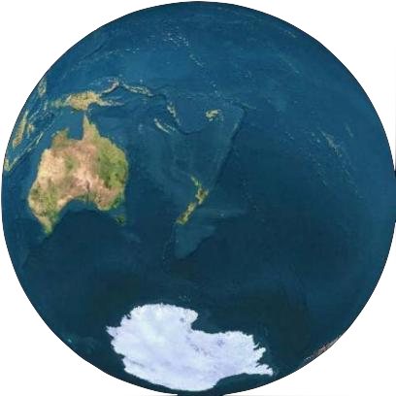
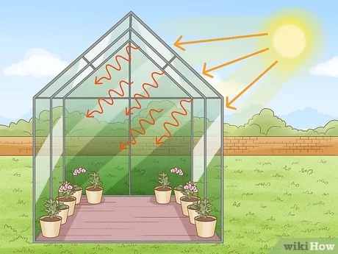
Greenhouse Effect
In Thermodynamics II from heating by the Sun, we obtained an average Earth surface temperature of -18 ºC. This is brought up to, a more pleasant, 15 ºC by the Greenhouse Effect
This increases the Earth’s surface temperature as:
Long wavelength IR thermal radiation from Earth’s surface is absorbed by atmospheric greenhouse gases, such as water vapour, carbon dioxide, methane.
Atmospheric gases re-radiate energy (also long wavelength IR) both into space AND back towards the Earth’s surface.
The Earth must absorb this extra energy, so its surface temperature rises. By raising the temperature the dynamic equilibrium is maintained.

Slide 2
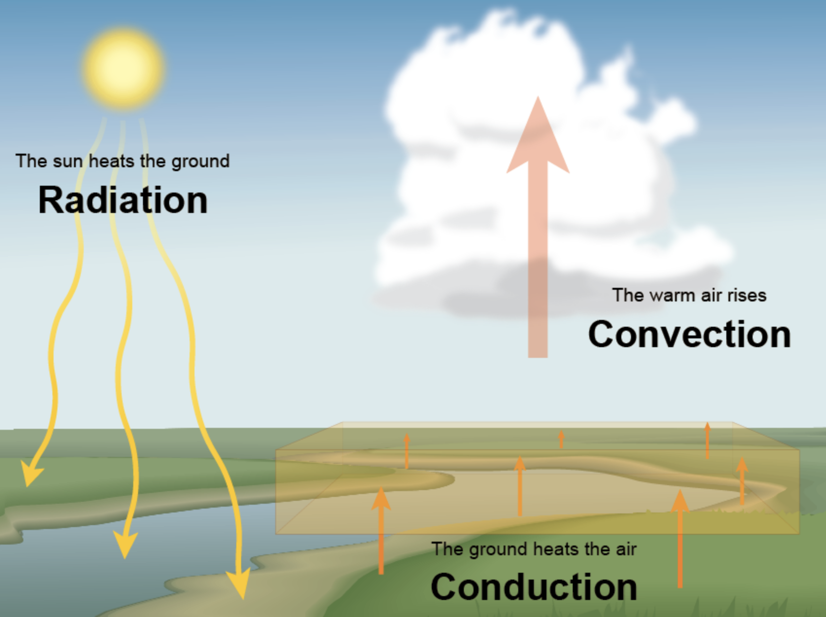
Energy Transfer
Radiation is transmitted by electromagnetic waves (even through a vacuum) and is received by particles as kinetic energy.
Conduction is the movement of kinetic energy in materials from higher temperature areas to lower temperature areas. The molecules will simply give their energy to adjacent molecules until an equilibrium is reached.
Convection is heat transfer through fluid motion, unlike conduction the medium itself moves transferring the heat, whereas for conduction the heat moves by wiggling the atoms/molecules.

Slide 3
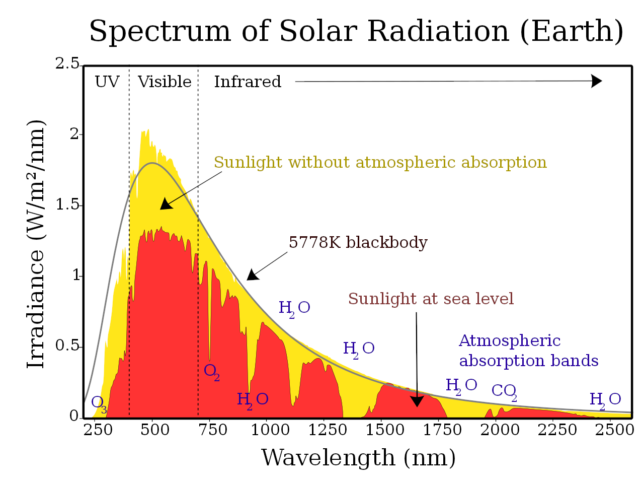
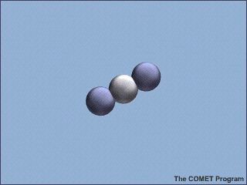
Greenhouse Gas Mechanisms
Carbon dioxide and other greenhouse gas molecules can absorb infrared radiation coming from the Sun. This excites the molecule (via a vibrational transition) and some time later the molecule de-excites, re-emitting the radiation. This emission is isotropic, emitting in all directions.
In addition to the radiation which reaches the ground unabsorbed, some of the re-emitted radiation also reaches the ground and some is reflected back into the atmosphere, where it can be re-absorbed.
Notes:
CO2 absorbs IR radiation in two narrow bands around wavelengths 4.26 and 15 μm (wavenumbers 2,349 and 667 cm-1) and in narrow bands around 2.7 and 2 μm.

Slide 4
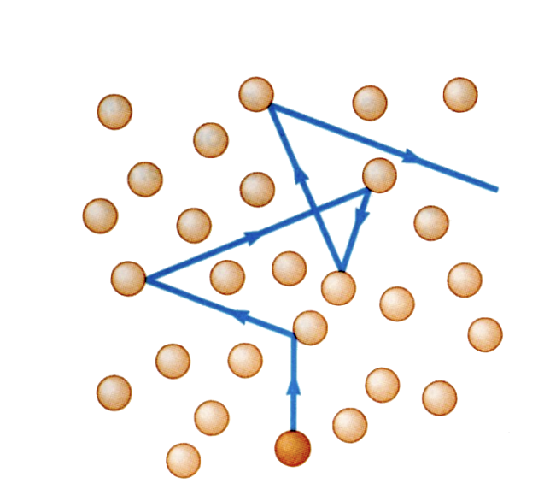
As well as this radiative excitation, molecules can be excited by collisions with other molecules (a very important mechanism in the interstellar medium) - the warmer (faster moving) the molecules, the more likely the excitations and the production of more infrared photons, thus causing a positive feedback loop. Recall, from SPCE102,
In addition to the average speed, the molecule’s mean free path is important.
This is, the distance an average molecule
travels before colliding with another.

Slide 5
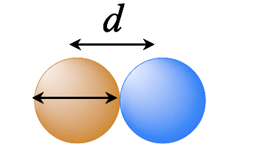
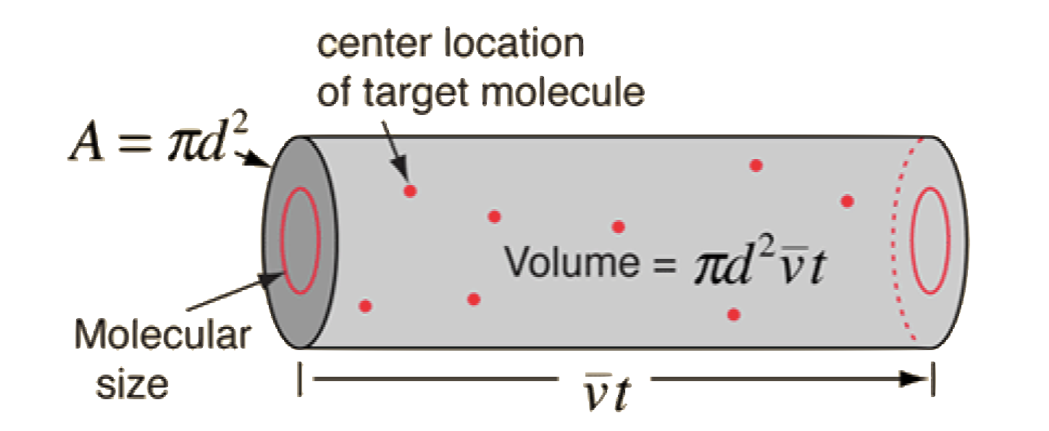
Mean Free Path
We model this as a random walk, with an average time between collisions, t. We can treat the molecules as symmetrical with diameter d.
With an average speed of v, the particle will move a distance vt before colliding. In order for a collision to occur the maximum spacing between the particles is d.
So over time we can consider the particle sweeping out a cylinder of length vt and cross sectional area A = πd ²

Slide 6
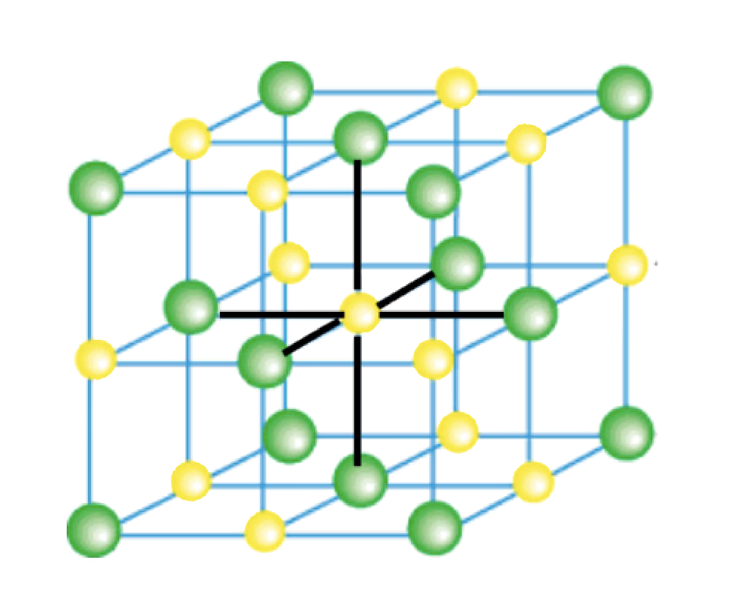
To get the mean free path length, l = vt, we equate the volume available to each particle with the volume swept out
A particle sweeping out a cylinder of length vt and cross sectional area A = πd ² sweeps out a volume V = πd ² vt , so
l = vt = V / A = V / πd ²
E.g. for air at room temperature and one atmosphere of pressure, the number of N₂ molecules per unit volume is n_{V} ≃ 1.225/4.65 x 10⁻²⁶ = 2.63 x 10²⁵ and so the average volume occupied by each molecule is 1/2.63 x 10²⁵ ≃ 3.80 x 10⁻²⁶ m³.
For N₂, d = 0.305 nm, so
l = V/ πd ² ≃ 3.80 x 10⁻²⁶ / π (0.305 x 10⁻⁹)² = 1.30 x 10⁻⁷ m.
So the mean free path length is l ≃ 130 nm.

Slide 7
If l = 130 nm, on average,
How long between collisions?
How many particles are missed before a collision?
Both of these depend on how fast the particles are moving and, hence, the temperature. At room temperature, the average N₂ molecule has a speed of ~ 510 m s⁻¹ and so
t = l /v = 1.30 x 10⁻⁷ / 510 = 2.55 x 10⁻¹⁰ s, or 1/ 2.55 x 10⁻¹⁰ = 3.9 x 10⁹ = 3.9 billion collisions per second
We calculated that the average volume occupied by each molecule is V = 3.80 x 10⁻²⁶ m³, which corresponds to a linear size of L = V ^{1/3} = 3.37 x 10⁻⁹ m.
If the average separation is L = 3.37 nm (about 11 molecular diameters) and l = 130 nm, the average particle misses 130/3.37 = 35 other particles before a collision.

Slide 8
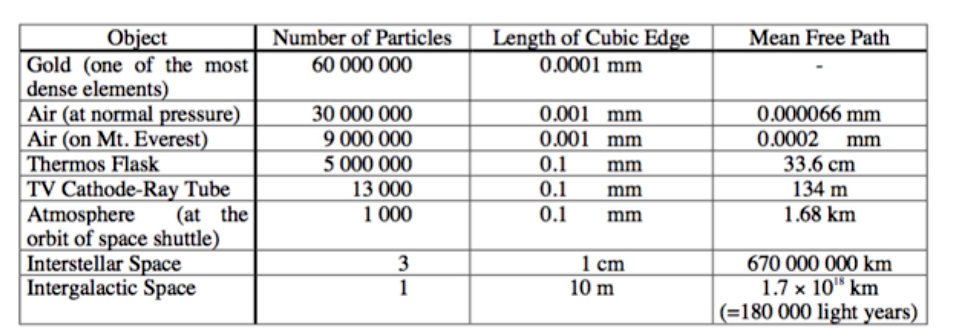
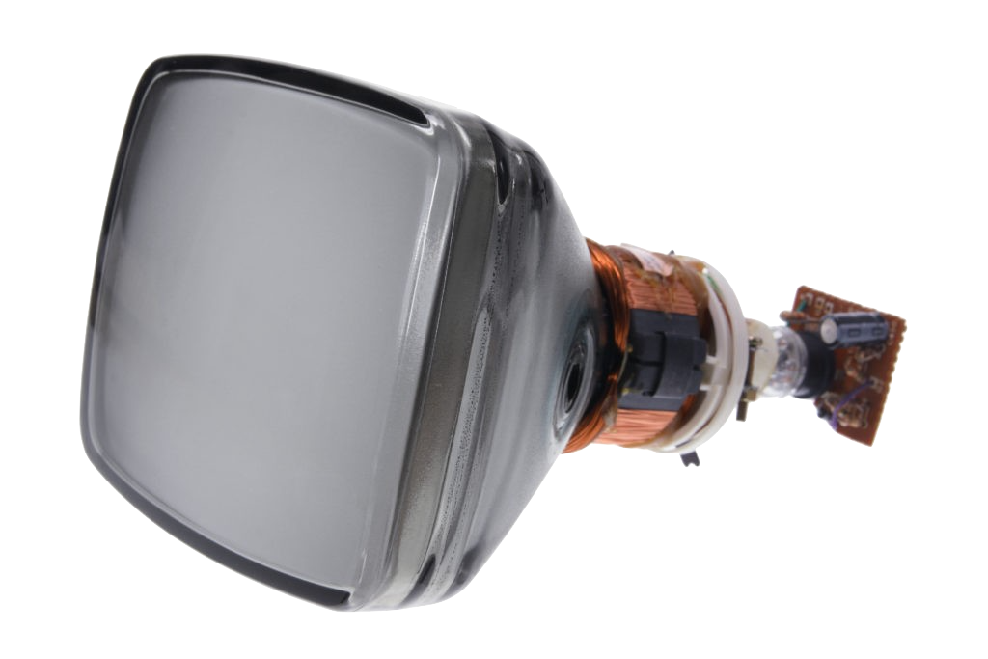
l = 130 nm compared to 66 nm in table, although there is a factor of √2 due to the average relative speed (giving l = 90 nm). Also, size measurements of the molecule have improved (d = 0.305 nm for N₂).
The alues above are in the right ballpark though.

Slide 9
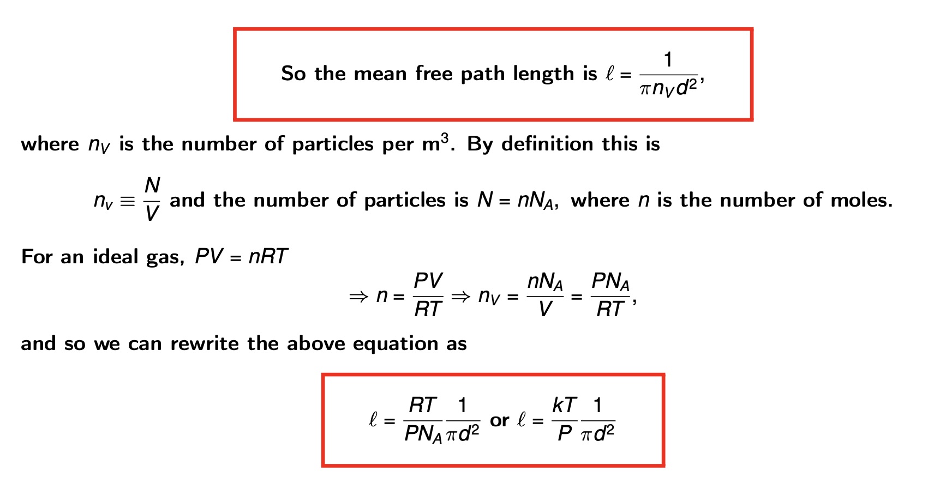

Slide 10

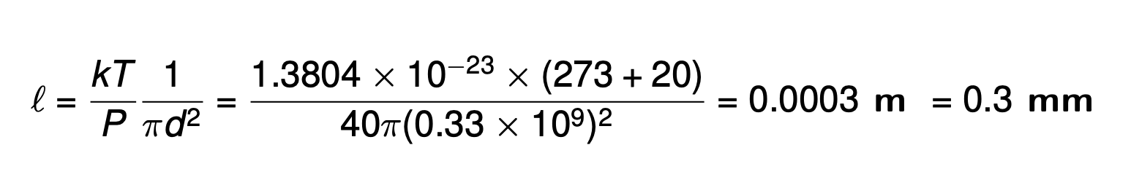
l ∝T isn’t that a good thing?
No, because faster particles are more likely to have sufficient kinetic energy for the quantum leap required to excite the CO₂
CO₂ is currently 0.04% of the atmosphere, so from Daltons’ Law of Patrial Pressures:
P = P₁ + P₂ + P₃ +…,
the pressure of CO₂ (d = 0.33 nm) is 0.04/100 x P = 0.0004 atmospheres ~ 40 Pa at sea level. The mean free path length at 20ºC is therefore

Slide 11
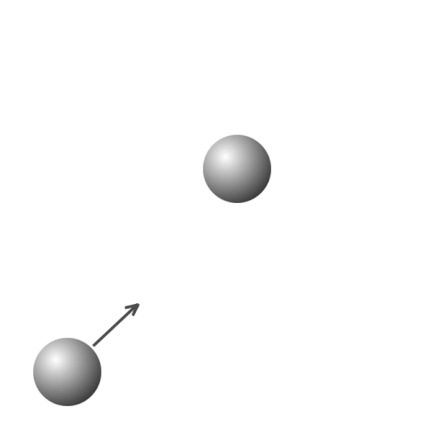
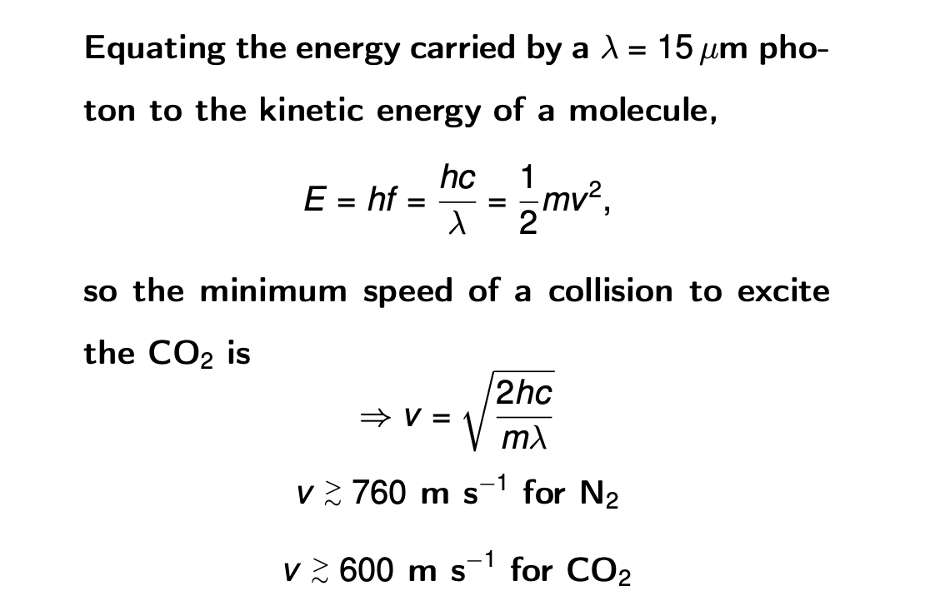
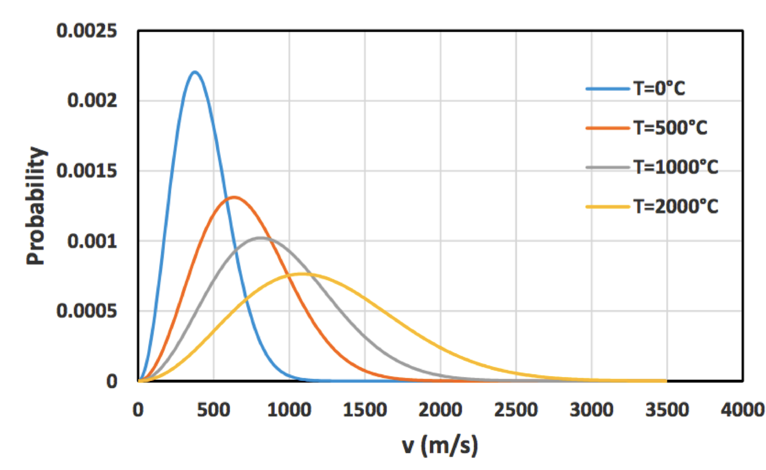
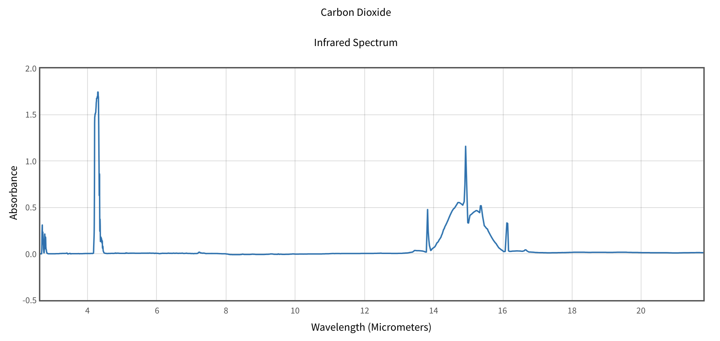
E₂
E₁
O₂ at various temperatures

Slide 12
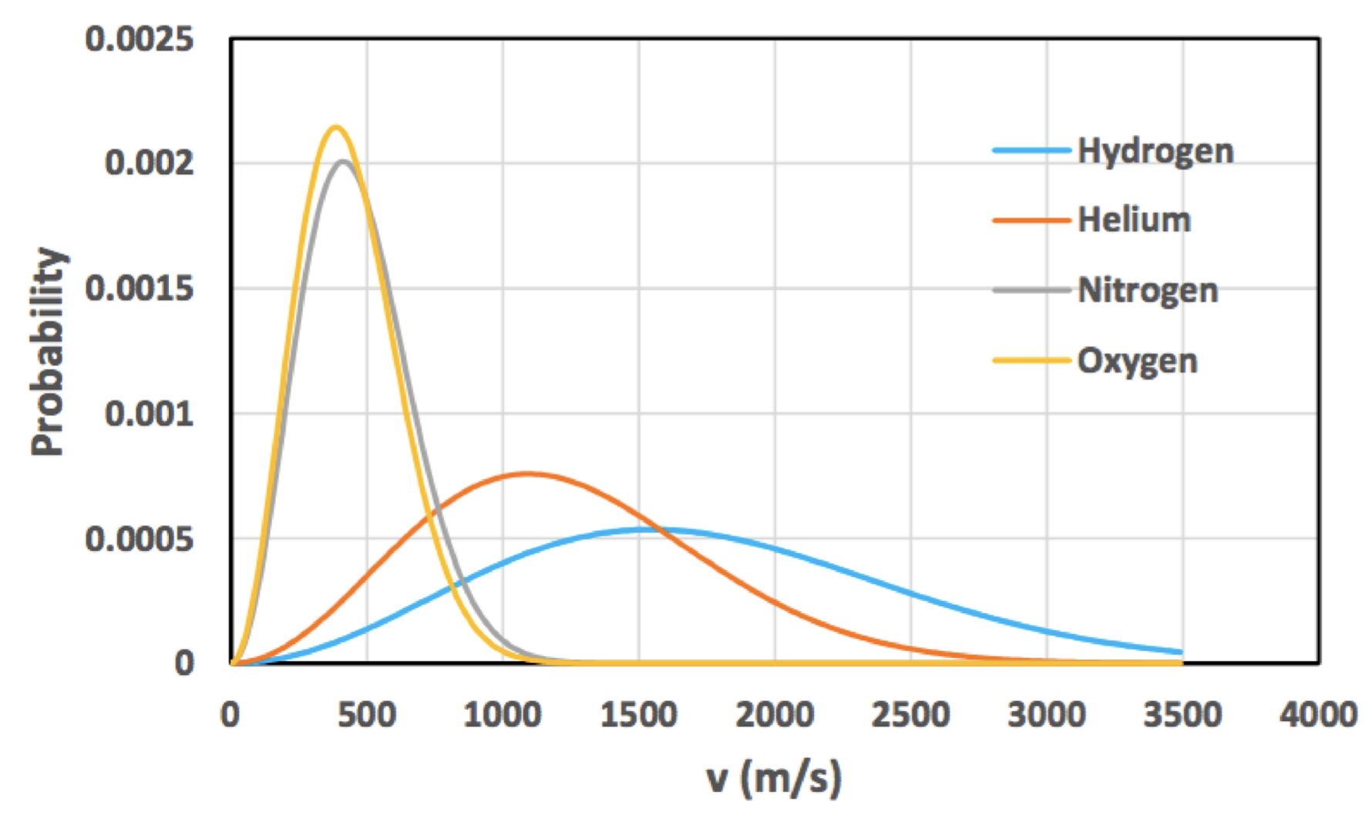
CO₂ is only 0.04% of atmosphere giving l = 0.30 mm, at sea level and T = 20ºC. This is over 2000 times the mean free path length of N₂ (78%) and so a collision with this is much more likely. This goes for all the other greenhouse gases, H₂O, CH₄, NO, O_{3,} etc.
We have shown, however, that
l ∝T/P,
so the higher the temperature (or lower the pressure) the longer the mean free path. However, warmer gas means more energetic particles and thus a greater chance of one having the critical energy needed to excite the greenhouse gas molecule.
O₂ at various temperatures
Various species at T = 13ºC

Slide 13
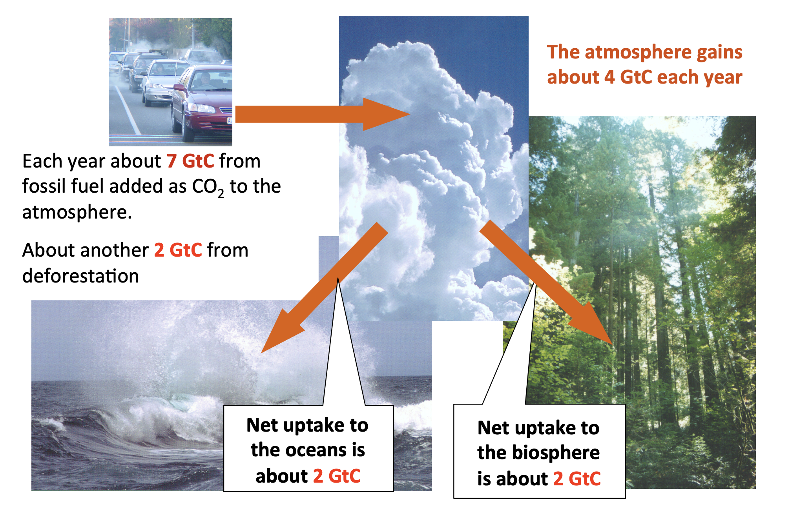
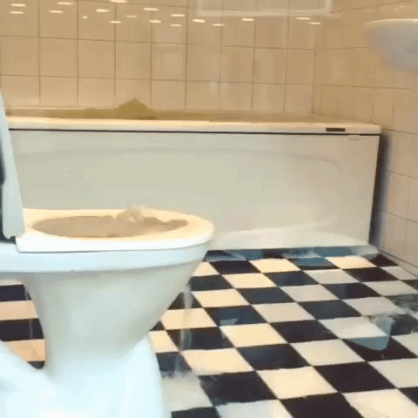
It doesn’t have to be much, just a constant little trickle from the tap
Again, like the melting
ice reducing the
Earth’s albedo,
this is a positive
feedback loop leading to a runaway greenhouse effect (check out the state of Venus).

